Slide 1
Nantes Machine Learning Meet-up 2 February 2015 Stefan Knerr CogniTalk
Building High-level Features Using Large Scale Unsupervised Learning
Q.V. Le, M.A. Ranzato, R. Monga, M. Devin, K. Chen, G.S. Corrado, J. Dean, A.Y. Ng
Google & Stanford University
(now some authors are with Facebook or Baidu)

Slide 2
Reading Group
Goal: understand what’s going on in the research community.
Means: read papers from other researchers and discuss with others in order to better understand.
You are supposed to read the paper before the reading group event.
You come with your level of understanding, questions, comments, …
A reading group should be participative & interactive.

Slide 3
Why today’s paper?
Today’s paper is about Deep Learning.
Deep Learning currently gets a lot of attention: big companies, newspapers, CES, VCs, …
Deep Learning has produced a number of very impressive and intriguing results.
Deep Learning is finally possible ← computing power, data available, algorithms improved.
However, the real reason is that Jeff has chosen the “cat face” from today’s paper as the symbol for this Machine Learning meet-up. I felt that needed some explanation … ☺.

Slide 4
Disclaimer
I have taken the following slides from various sources and authors on the web, most importantly from slides by Quoc V. Le, first author of today’s paper.
I have made changes, comments, and I have added some other stuff.
Any possible problems with the slides or false statements are probably my fault. Don’t blame anything on the original authors.

Slide 5
Image Recognition
Associate a class label with an image
Sometimes ambiguous: several objects
in image (Seg), what semantic level of labeling?, …
Find specific class(es), versus label anything

Slide 6
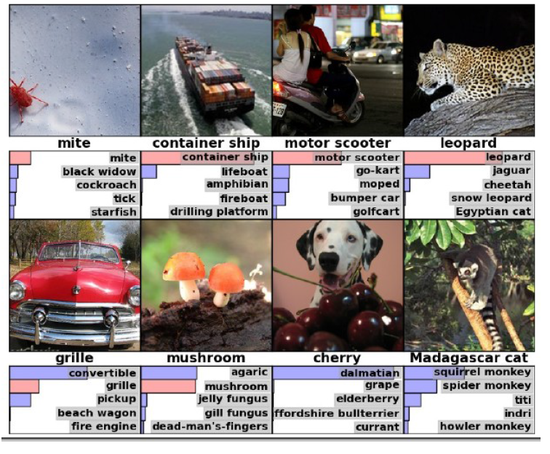
Quiz on ImageNet data set images?
Container ship
Motor scooter
Grille
Cherry
Madagascar cat

Slide 7
Image Recognition
Traditionally several processing steps (divide and conquer): Feature extraction + Classification.
Feature Extraction mostly hand crafted.
Classifier trained on mostly labeled (or unlabeled) data.
Classifier
Human Face
Feature Extraction
(often hand crafted)

Slide 8
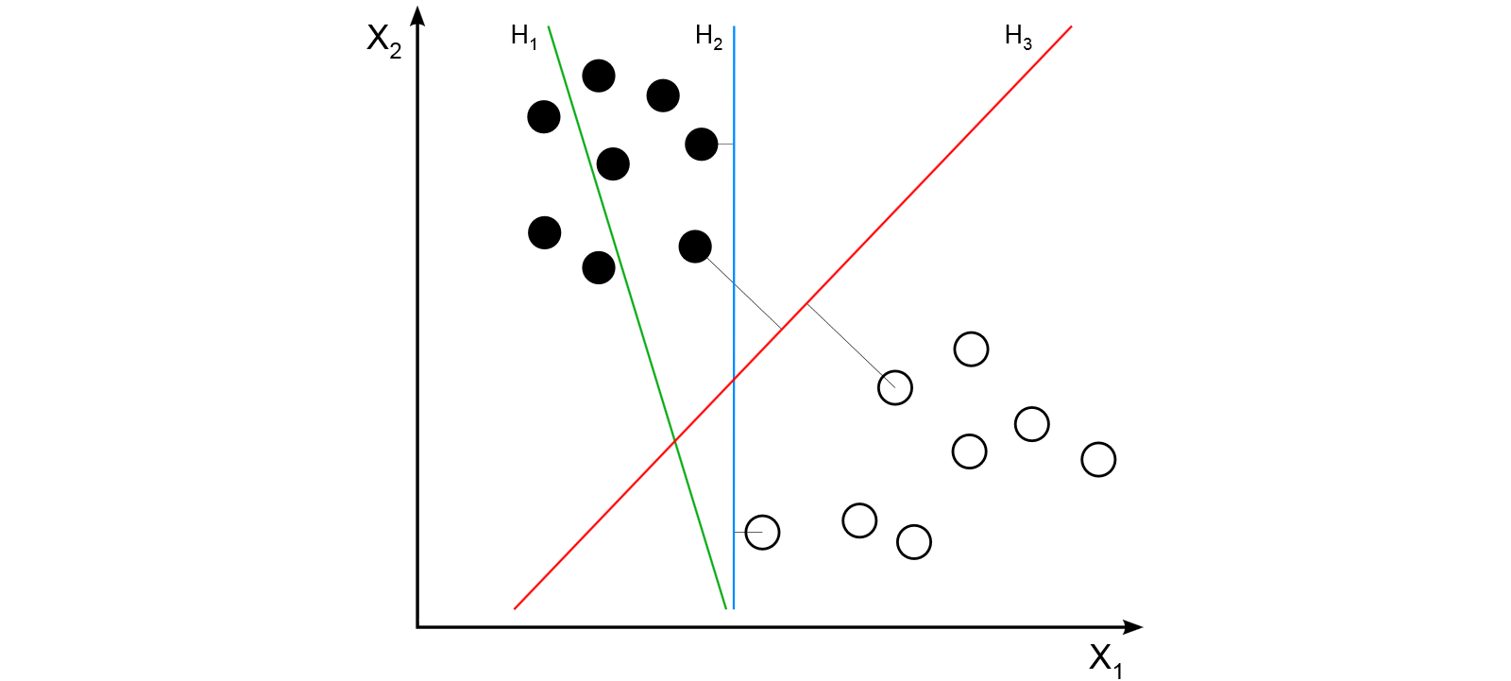
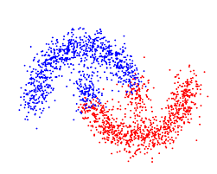
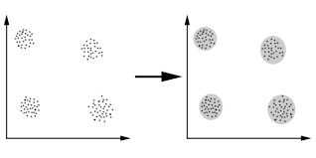
Supervised versus Unsupervised Learning of Classifiers
Supervised Learning needs couples of {image, class label}.
That can be expensive. Sometimes difficult to get your hands on large labeled data sets. Wrong labels.
Unsupervised Learning: no category labels provided
Clustering (e.g. k-means)

Slide 9
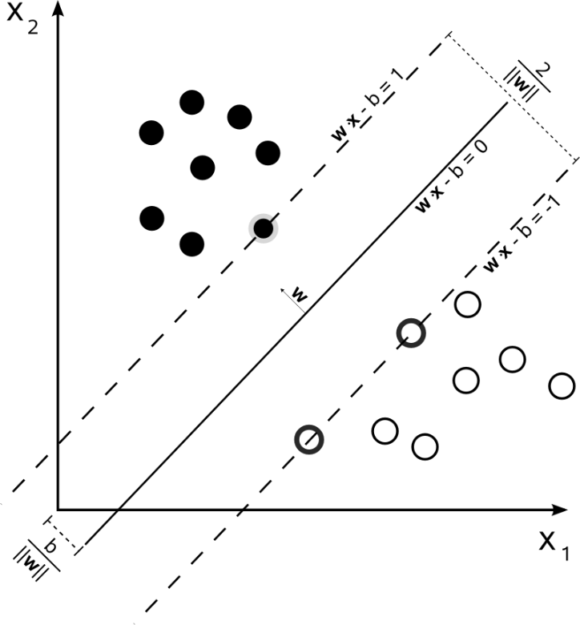
Neural Networks (1)
Classification problem with 2 categories in 2 dimensions. Here linearly separable.
Single neuron, SVM.
Supervised training as optimization problem. E.g. minimize a cost function on outputs through gradient descent.
x₁
x₂
x₁
x₂
This is like a 2 pixel image: x₁, x₂.
Optimal margin classifier (SVM).

Slide 10
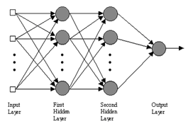
Neural Networks (2)
Several neurons, several layers (Multi-Layer-Perceptron) allow for more elaborate non-linear separations than simple hyperplanes.
Linear, sigmoidal, softmax, … transfer functions.
Supervised training with cost function on outputs through gradient descent (Backpropagation).
Proof that such a neural network (1 hidden layer) can implement any mapping from inputs to outputs if large enough.

Slide 11
Deep Neural Networks
Many hidden layers
Learn hierarchical feature representations and classifier at the same time.
History: Fukushima (early 80ies), Le Cun (late 80ies), …
Convolutional Nets (CNN)
Restricted Boltzmann Machines (RBM)
Deep Believe Nets (DBN)
…
Cf. Rich Caruana’s work on reproducing accuracies similar to deep networks with shallow networks.

Slide 12
Convolutional Nets for image recognition (e.g. Le Cun et al.)
Fukushima, LeCun, …
No explicit segmentation. Compute map for each category with P(category | image) at specific position.
No explicit (hand crafted) feature computation. Features are learned.
Sequence of convolutions and pooling.
Supervised learning with Stochastic Gradient Descent (SGD) and mini-batches.
Many other tricks: weight initialization, gradient adaption, drop-out, …

Slide 13
Conv Nets produce typically low level (Gabor like) feature detectors
Color blob detectors
Edge detectors
Color or gray-level gradient detectors
…
What about high level features? Needs more data? → unsupervised learning.

Slide 14
Examples of recognition
From Krizhevsky, Sutskever, Hinton (2012)

Slide 15
Autoencoders
Neural Network for generation of latent (usually compressed) data/feature representation.
Unsupervised training: no class labels needed. Reproduce target output = input.
Can be trained through backpropagation: minimize difference between reproduced output and input.
Latent representation needs to have all important information in order to reproduce the input.
Related to PCA.
Decoding weights
Encoding weights
input
target output

Slide 16
Deep autoencoders
Build deep autoencoder by treating the outputs of a latent layer as input to the next layer.
Relationship between Sparse coding, Autoencoder, Independent Component Analysis, Restricted Boltzmann Machines.

Slide 17
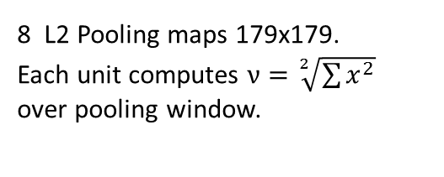
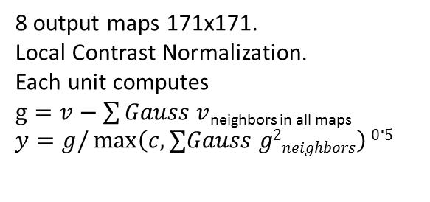
Architecture of 1 layer of Quoc V. Le autoencoder
3x
W₁
H
18x18 receptive fields.
Not convolutional.
Each unit sees all channels.
Parameters W₁.
5x5 pooling.
Fixed weights.
Each unit sees
only own channel.
5x5 kernels.
Each unit sees
all channels.
8 feature maps 183x183.
Each linear unit computes ∑W₁x_{i}
8 L2 Pooling maps 179x179.
Each unit computes $ν=\sqrt[2]{\sum{x^{2}}}$
over pooling window.
8 output maps 171x171.
Local Contrast Normalization.
Each unit computes
$g=v−\sum{Gauss v}$_{neighbors in all maps}
$$y=g/\max\left(c, ∑Gauss g2neighbors\right)0.5$$
3 x 200 x 200 image x_{i}

Slide 18
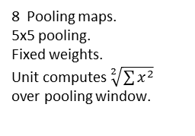
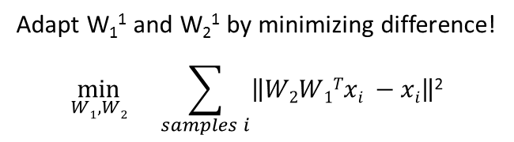
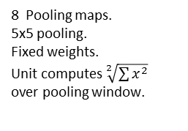
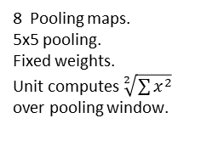
Adapt W₁¹ and W₂¹ by minimizing difference!
$$\min_{W1, W2}{}\sum_{samples i}{\left\|W2W1Txi −xi\right\|\text{2 }}$$
This leads to soft decisions, even when neurons encode important info for reconstruction.
No unit will take a specific category related responsibility.
→ Question: how to constrain the neurons to pick up high level feature responsibility?
LCN maps from prior layer
LCN maps from prior layer
W₂¹
W₂²
W₂³
W₁¹
W₁²
W₁³
H
H
H
3 x 200 x 200 image x_{i}
8 feature maps.
18x18 receptive fields.
Not convolutional.
Unit computes ∑W₁x_{i}
8 LCN maps.
5x5 kernels.
Unit computes
8 feature maps.
18x18 receptive fields.
Not convolutional.
Unit computes ∑W₁x_{i}
8 LCN maps.
5x5 kernels.
Unit computes
8 feature maps.
18x18 receptive fields.
Not convolutional.
Unit computes ∑W₁x_{i}
8 LCN maps.
5x5 kernels.
Unit computes
8 Pooling maps.
5x5 pooling.
Fixed weights.
Unit computes $\sqrt[2]{\sum{x^{2}}}$
over pooling window.
8 Pooling maps.
5x5 pooling.
Fixed weights.
Unit computes $\sqrt[2]{\sum{x^{2}}}$
over pooling window.
8 Pooling maps.
5x5 pooling.
Fixed weights.
Unit computes $\sqrt[2]{\sum{x^{2}}}$
over pooling window.
Training

Slide 19
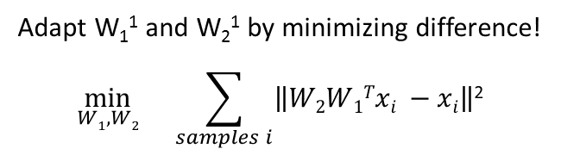
Forward through entire network
Compute all contributions to cost function
Backpropagate
Adapt W₁¹ and W₂¹ by minimizing difference!
$$\min_{W1, W2}{}\sum_{samples i}{\left\|W2W1Txi −xi\right\|\text{2 }}$$
LCN maps from prior layer
LCN maps from prior layer
W₂¹
W₂²
W₂³
W₁¹
W₁²
W₁³
H
H
H
3 x 200 x 200 image x_{i}
8 feature maps.
18x18 receptive fields.
Not convolutional.
Unit computes ∑W₁x_{i}
8 LCN maps.
5x5 kernels.
Unit computes
8 feature maps.
18x18 receptive fields.
Not convolutional.
Unit computes ∑W₁x_{i}
8 LCN maps.
5x5 kernels.
Unit computes
8 feature maps.
18x18 receptive fields.
Not convolutional.
Unit computes ∑W₁x_{i}
8 LCN maps.
5x5 kernels.
Unit computes
8 Pooling maps.
5x5 pooling.
Fixed weights.
Unit computes $\sqrt[2]{\sum{x^{2}}}$
over pooling window.
8 Pooling maps.
5x5 pooling.
Fixed weights.
Unit computes $\sqrt[2]{\sum{x^{2}}}$
over pooling window.
8 Pooling maps.
5x5 pooling.
Fixed weights.
Unit computes $\sqrt[2]{\sum{x^{2}}}$
over pooling window.
Training

Slide 20
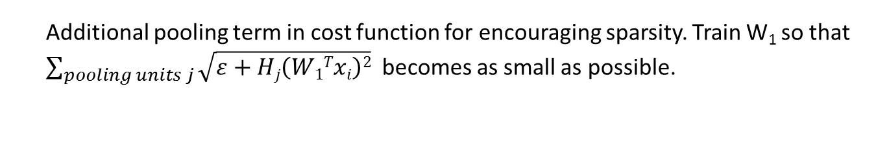
Additional pooling term in cost function for encouraging sparsity. Train W₁ so that
$\sum_{pooling units j}{\sqrt{ε+Hj\left(W1Txi\right)2}}$ becomes as small as possible.
LCN maps from prior layer
LCN maps from prior layer
W₂¹
W₂²
W₂³
W₁¹
W₁²
W₁³
H
H
H
3 x 200 x 200 image x_{i}
8 feature maps.
18x18 receptive fields.
Not convolutional.
Unit computes ∑W₁x_{i}
8 LCN maps.
5x5 kernels.
Unit computes
8 feature maps.
18x18 receptive fields.
Not convolutional.
Unit computes ∑W₁x_{i}
8 LCN maps.
5x5 kernels.
Unit computes
8 feature maps.
18x18 receptive fields.
Not convolutional.
Unit computes ∑W₁x_{i}
8 LCN maps.
5x5 kernels.
Unit computes
8 Pooling maps.
5x5 pooling.
Fixed weights.
Unit computes $\sqrt[2]{\sum{x^{2}}}$
over pooling window.
8 Pooling maps.
5x5 pooling.
Fixed weights.
Unit computes $\sqrt[2]{\sum{x^{2}}}$
over pooling window.
8 Pooling maps.
5x5 pooling.
Fixed weights.
Unit computes $\sqrt[2]{\sum{x^{2}}}$
over pooling window.
Training

Slide 21
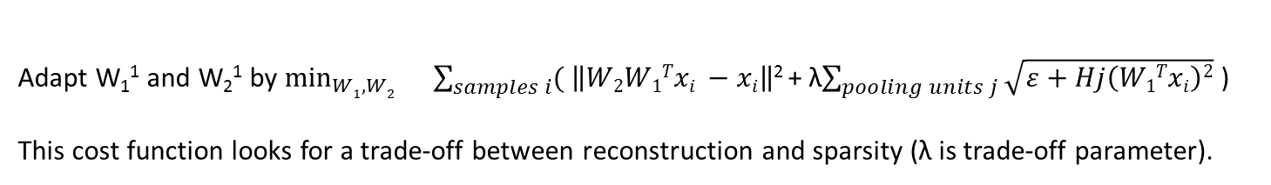
Adapt W₁¹ and W₂¹ by $\min_{W1, W2}{}\sum_{samples i}{( \left\|W2W1Txi −xi\right\|\text{2 }}$+ λ$\sum_{pooling units j}{\sqrt{ε+Hj\left(W1Txi\right)2}}$ )
This cost function looks for a trade-off between reconstruction and sparsity (λ is trade-off parameter).
LCN maps from prior layer
LCN maps from prior layer
W₂¹
W₂²
W₂³
W₁¹
W₁²
W₁³
H
H
H
3 x 200 x 200 image x_{i}
8 feature maps.
18x18 receptive fields.
Not convolutional.
Unit computes ∑W₁x_{i}
8 LCN maps.
5x5 kernels.
Unit computes
8 feature maps.
18x18 receptive fields.
Not convolutional.
Unit computes ∑W₁x_{i}
8 LCN maps.
5x5 kernels.
Unit computes
8 feature maps.
18x18 receptive fields.
Not convolutional.
Unit computes ∑W₁x_{i}
8 LCN maps.
5x5 kernels.
Unit computes
8 Pooling maps.
5x5 pooling.
Fixed weights.
Unit computes $\sqrt[2]{\sum{x^{2}}}$
over pooling window.
8 Pooling maps.
5x5 pooling.
Fixed weights.
Unit computes $\sqrt[2]{\sum{x^{2}}}$
over pooling window.
8 Pooling maps.
5x5 pooling.
Fixed weights.
Unit computes $\sqrt[2]{\sum{x^{2}}}$
over pooling window.
Training

Slide 22
Training of Autoencoder
Stochastic gradient descent. Minimize difference between
input image and reconstructed image. No image labels used.
Unsupervised training.
Pooling layer weights are fixed.
RICA = Reconstruction Independent Component Analysis

Slide 23
Image recognizer
Classifier
Pretrained (unsupervised) autoencoder + supervised classifier on top.
Classifier: 1-versus-all logistic classifier.
First train the classifier, then fine-tune the whole network (encoder + classifier).
Fine tuning is also supervised.

Slide 24
ImageNet Data Set
http://www.image-net.org/
Data set is structures like WordNet hierarchy of concepts. > 100 000 concepts.
For each concept > 1000 images (goal).
Total ~ 15 Million color images for ~ 22 000 categories.
Each image is labeled. There is ambiguity.
Check out ILSVRC competitions.

Slide 26
Results (Quoc V. Le et al. 2012)
ImageNet, 20 000 categories:
Random guess with 20 000 categories → 0.005%.
Best published result before: 9.5% (Weston et al., 2011).
This paper: 15.8%. 70% relative improvement.
Human performance?
ImageNet, 10 000 categories:
This paper: 19.2%.
ImageNet, 1 000 categories:
This paper: > 50%.
Today:
Siberian husky
Eskimo dog
2 distinct categories in the ILSVRC 2014 challenge.

Slide 27
Cat neuron activations
Random images
Cat faces
Frequency
Feature value
The cat neuron tends to respond positively to cat face images and negatively to other stuff.
Images have been resized (80x80) in order to fit the receptive field of the corresponding neuron.

Slide 28
Cat detectors
O
Cat faces with highest recognition scores.
Optimal cat face computed by numerical optimization
using the trained autoencoder.
Numerical optimization: optimize input (not autoencoder parameters) for highest possible activation of the
“cat neuron” in the latent representation of the autoencoder.

Slide 29
Human face detector

Slide 30
Recognition invariances

Slide 31
Grandmother neuron
A concept is encoded by a single neuron in the brain.
When exposed to perceptual input associated with this concept the neuron is activated.
“Grandmother neuron” concept introduced by J.P. Changeux.
Livre: “L’home neuronal”, Pluriel, 1983.
Plausibility: humans generally know about a few million concepts. No pb to encode each concept by one or an assembly of neurons. But …
Brain: ~ 10¹¹ neurons and ~10¹⁴ synapses.

Slide 35
Open questions and future work
What is unclear?
What could/should be improved?

